Slide 1

June 12, 2019
Wii:
Password:

Slide 2

Welcome & Introductions
www.lihealthcollab.org

Slide 3
LIHC Updates
Walk With A Doc – June 30th
Walk Safe Long Island
Healthy Libraries project update
CDSMP training locations
August & October attendees
www.lihealthcollab.org

Slide 4
LIPHIP data capacity
1. When asked what the biggest ongoing health concerns in the community where you live are:
www.lihealthcollab.org

Slide 5
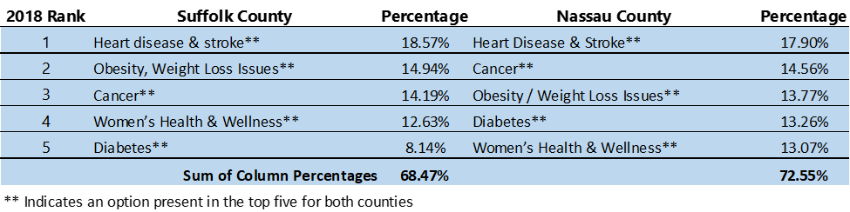
LIPHIP data capacity
2. When asked what the biggest ongoing health concerns for yourself are:
www.lihealthcollab.org

Slide 6

Networking Break
www.lihealthcollab.org

Slide 7
Long Island Addiction Resource Center
Shari Santoriello
Program Coordinator, LI-ARC
shari@hugsinc.org
www.lihealthcollab.org

Slide 8
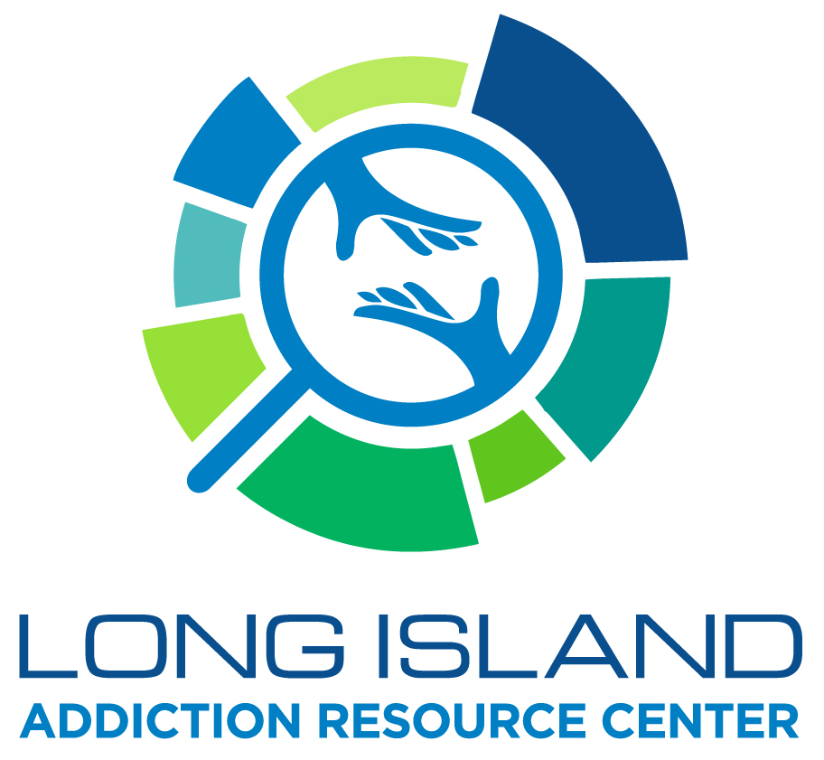
Notes:
Thanks so much for having me today. My name is Shari Santoriello and I am the Project Coordinator for the Long Island Addiction Resource Center. This year the Long Island Health Collaborative has identified substance use disorder and its prevention as one of their objectives. The Long Island Addiction Resource Center is one tool to help you so that. So today I’d like to give you an overview of what the Long Island Addiction Resource Center is and how it can support the work you do.

Slide 9

Notes:
So what is the Long Island Addiction Resource Center? Where did it come from and what can it do to support my organization? Once upon a time, NY State Office of Alcoholism and Substance Abuse Services (OASAS for short), realized that there were many programs throughout New York State to help with substance use and other addiction-related disorders, but many didn’t know how to find that information. So, a grant was developed to help meet this challenge head on.

Slide 10


Notes:
HUGS, Inc, Human Understanding and Growth Services, a strong prevention organization in Suffolk County that provides individuals, families, schools and communities with prevention education strategies aimed at reducing high risk behaviors among our youth while building positive attitudes to improve all areas of life. AND FIST, Families In Support of Treatment, a strong family-centered organization in Nassau County, that was created to help families who have loved ones struggling or have struggled with the disease of addiction got together to apply for the grant and start building the “ARC”

Slide 11
Notes:
They were awarded the grant and that’s how the Long Island Addiction Resource Center was born! Affectionately know as the LI-ARC for short!
LI-ARC is an OASAS-funded community awareness initiative to support all the service agencies across Nassau & Suffolk counties.
This bi-county collaborative effort is aimed at all populations – community members, addiction disorder field professionals, substance use disorder field professionals and those who are suffering from or know someone who is or was suffering from the disease of addiction.

Slide 12

Notes:
What is an “ARC” really?
The LI-ARC has three main functions. The first is to provide a searchable database – virtually –a google on steroids, to list any and all services that relate to substance use disorder – beginning with prevention, treatment and through to long-term recovery, and other supportive services. The website will also host a Speaker’s Bureau that lists vetted speakers, often who are free of charge to our community at large, and a calendar of events. It’s like an umbrella and a safety net ……
The website is currently being built and we are very excited to share it with you!

Slide 13

Notes:
The second function is to get this information in the hands of the people who need it, no matter who you are.

Slide 14
Notes:
In order to get the word out, the LI-ARC wants to partner with as many organizations as possible to support the already incredible work you are doing. Whether it is social media, tabling at your event, or helping to provide some financial assistance in the form of a mini-grant. The mini-grant program runs all year long and applications are taken on a rolling basis. Grants will be continually awarded until funding runs out. These mini-grants are designed to fund projects over and above what is included in your work plan if you are already OASAS-funded – no double dipping. If you are not OASAS-funded, it is designed to help you get going. So whether it is an evidence-based program or environmental strategies, like sticker shock or pizza box stickering, printing & distribution of informational card, supporting a community forum or raising awareness with media messaging, we’re here for you . Applications are in your folders.

Slide 15
Finding Help for
Substance Use and Addiction Disorders
on Long Island
https://www.surveymonkey.com/r/LI_Help
Notes:
The third thing we are tasked to do is to measure. With the help of epiphany community services, we are currently surveying to see how people find information on substance use and addiction disorders to help inform our website as we are building it. Feel free to take the survey and share the survey with your colleagues. There is a page in your folders.

Slide 16
Notes:
Any questions?

Slide 17
Recognitions
www.walksafeli.org [link]
www.lihealthcollab.org

Slide 18
2019 Meeting Dates
Wednesday, August 7
Wednesday, October 16
Thursday, December 12
LIHealthCollab.eventbrite.com
www.lihealthcollab.org

Slide 19
Adjournment
www.lihealthcollab.org

